Slide 1


Individual coaching & mentoring for lawyers
Individual leadership coaching is the most powerful tool to enable leaders to develop & increase their performance
Our coaches and mentors who have worked in law for many years or worked extensively with lawyers and other professionals as part of their coaching practice. They have a great understanding of the challenges and can provide coaching and mentoring to support you or your internal talent.

Slide 2
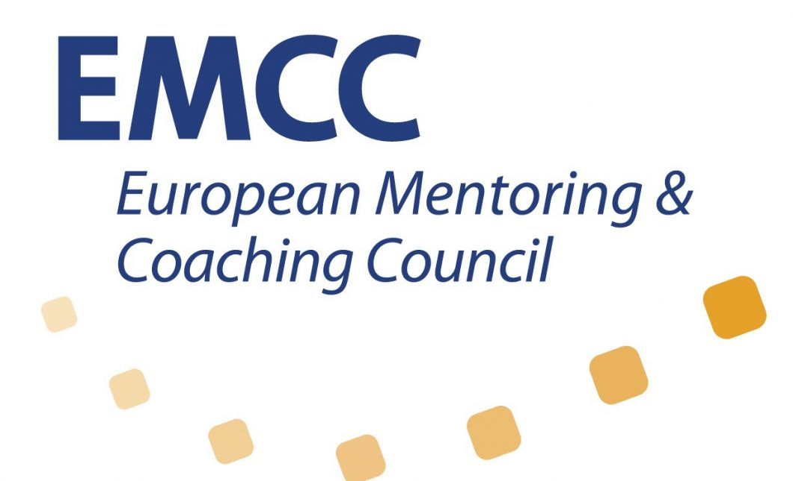


Coaching process
Leadership coaching is the art of enhancing performance, development, creativity and a sense of purpose at work by facilitating a change in thinking. All aiming to help you and the people working for you to thrive.
We support clients across many topics: business results, values alignment, new roles, work/life balance, leadership development, strategic direction, skills development & conflict resolution.
The coaching process
Matching
Ensuring a match with the most suitable coach to not waste time & guarantee an effective coaching trajectory
Contracting and objective setting
Ensuring that the coachee, the organization and the coach are clear on the objectives, agreed outcomes and the process of the coaching programme
A series of formal F2F or virtual coaching sessions
Providing support and challenge to the coachee in meeting their public and private objectives.
Mid review - halfway revisit and revise the coachee’s objectives
Evaluation and return on investment & expectation
Reviewing the impact of the coaching on an ongoing basis and at distinct stages through the programme
For further information please contact Ingrid.vanberkel@tpcleadership.com or Annelieke.Jense@tpcleadership.com

